Slide 1
1 Planed
plan 1
There are some tests in the video and 13 classes left, plan to finish them before next meeting.
The code comments! Aaaaa, I suddenly find that I have a lot of things to do.[sad,sad,sad].
4

Slide 2
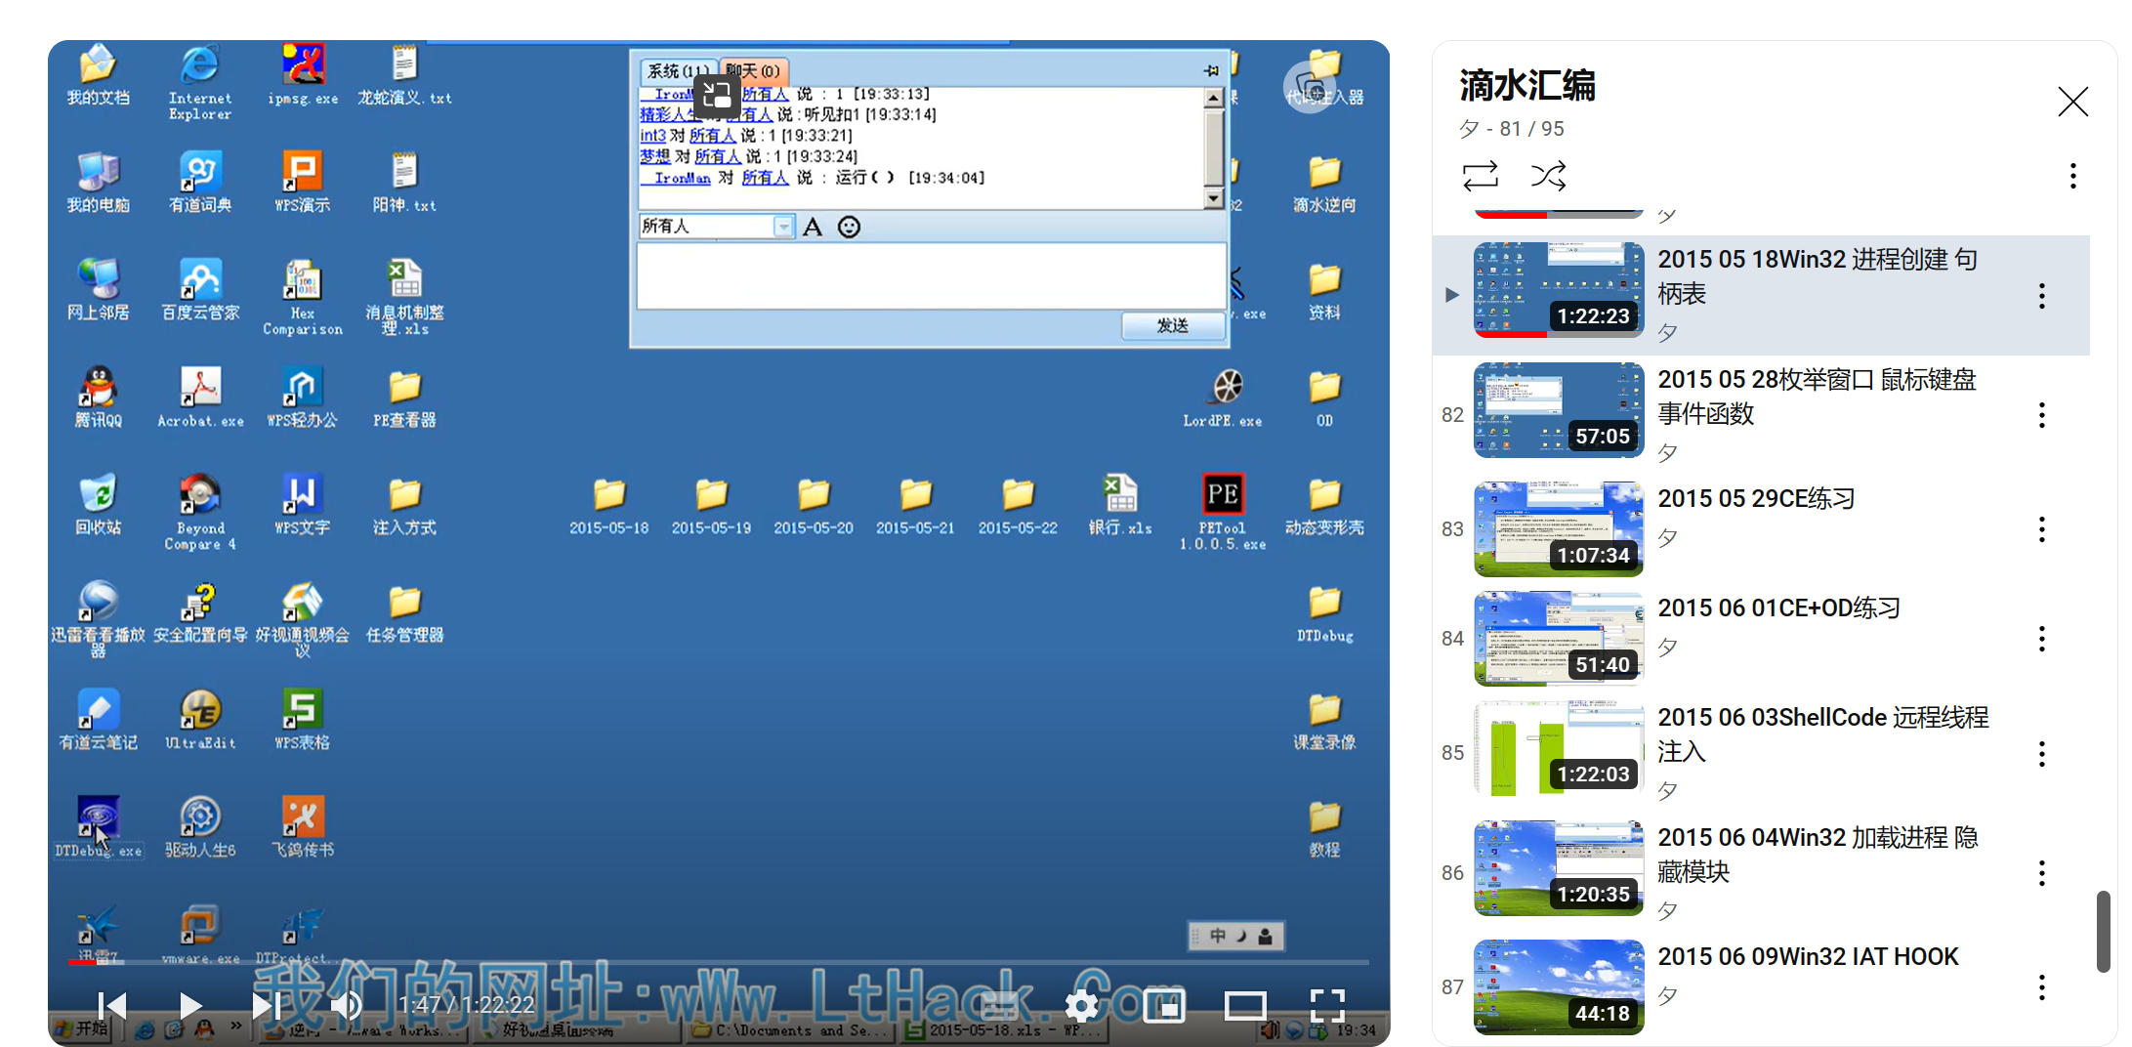
1 Results
Results 1
I finish the videos, but now I do not have a plan, I will make plan after the meeting tomorrow.
4

Slide 3
1 Challenges and Solutions
Challenges and solutions 1
What is the different between `OpenProcess` and `CreateProcess`?
4

Slide 4
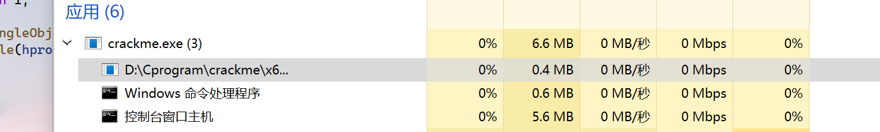
1 Challenges and Solutions
Challenges and solutions 1
The `PID` of a process exits just after the process is created right? I use task manager to get the message of a exe, finding that just the exe is executed its `PID` will exit, after I close the exe the `PID` disappears.
This is one process contains three threads or three process.
4

Slide 5
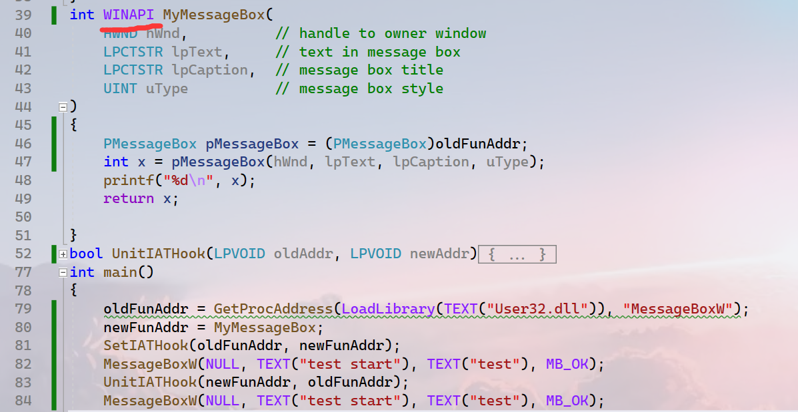
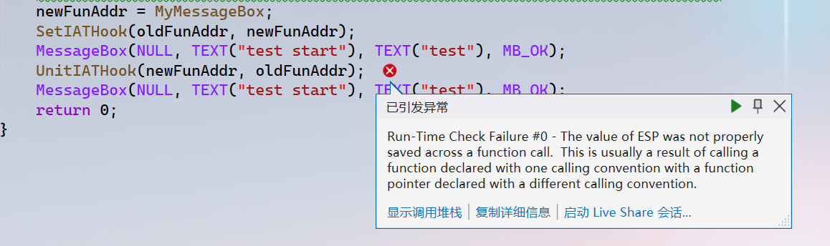
1 Challenges and Solutions
Challenges and solutions 1
I know what causes the exception. But why?
4

Slide 6
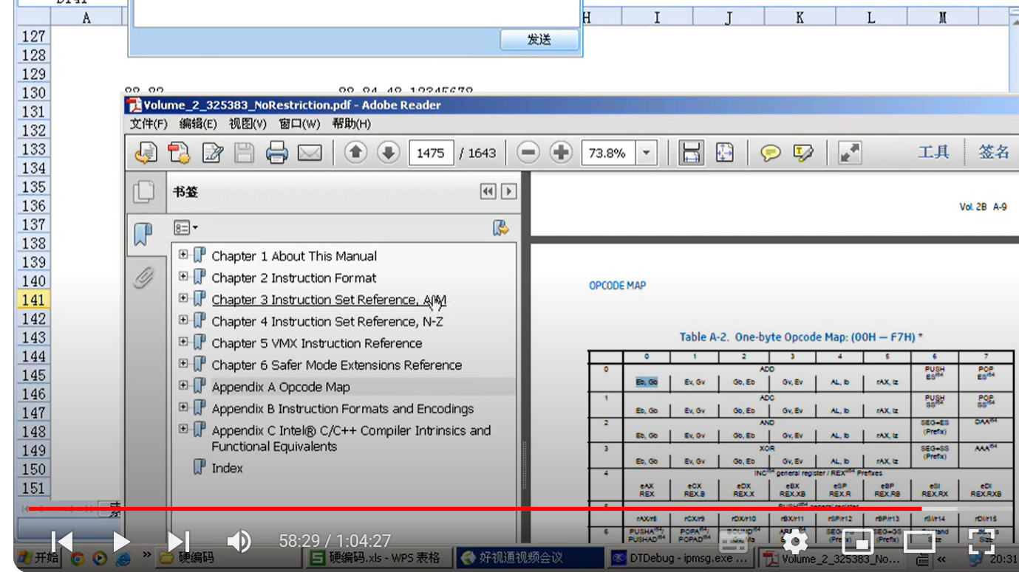
1 Challenges and Solutions
Challenges and solutions 1
Do you have this PDF? I do not know if I will use it.
4

Slide 7
1 Plan
plan 1
I will make a plan after the meeting tomorrow.
4

